Slide 1

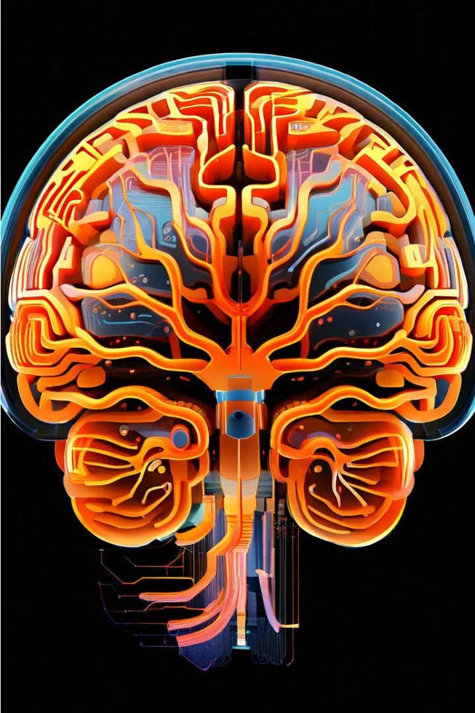
Introduction to Brain Tumor Classification
This presentation provides an overview of using convolutional neural networks (CNNs) for the classification of brain tumors. We'll explore the key steps involved, from dataset preparation to model training and evaluation, as well as the integration of Grafana for data visualization.

Slide 2

Overview of Convolutional Neural Networks (CNNs)
CNNs are a powerful deep learning technique well-suited for image classification tasks. They leverage the spatial relationships in data to automatically learn features and patterns, making them highly effective for medical imaging applications like brain tumor detection.

Slide 3

Dataset Preparation and Preprocessing
1
Data Acquisition
2
Data Preprocessing
3
Train-Val-Test Split
Collect a diverse dataset of brain MRI or CT scans, labeled with different tumor types.
Apply techniques like resizing, normalization, and augmentation to prepare the data for CNN training.
Divide the dataset into training, validation, and test sets to ensure reliable model evaluation.

Slide 4
CNN Model Architecture
Convolutional Layers
Pooling Layers
Fully Connected Layers
Extract low-level features like edges and shapes, then higher-level features like tumor patterns.
Reduce the spatial dimensions of the feature maps, while retaining the most important information.
Combine the extracted features to classify the input image into the correct tumor type.

Slide 5

Training and Validation of the CNN Model
1
Model Training
Use techniques like gradient descent and backpropagation to optimize the model's parameters and improve its performance.
2
Validation and Monitoring
Regularly evaluate the model's performance on the validation set to identify and address overfitting or underfitting.
3
Hyperparameter Tuning
Experiment with different hyperparameters, such as learning rate, batch size, and network architecture, to find the optimal configuration.

Slide 6




Grafana Integration for Visualization
Accuracy Trends
Loss Metrics
Classification Metrics
Interactive Dashboard
Monitor the model's training and validation accuracy over time.
Track the model's loss function to ensure convergence and identify potential issues.
Visualize the model's performance on the test set using a confusion matrix.
Create a customizable Grafana dashboard to monitor the model's overall performance.

Slide 7
Performance Evaluation and Metrics
Metric
Description
Value
Accuracy
Overall classification performance
92.5%
Precision
Ability to correctly identify positive cases
89.7%
Recall
Ability to correctly identify all positive cases
93.2%
F1-Score
Harmonic mean of precision and recall
91.4%

Slide 8




Conclusion and Future Directions
Effective Brain Tumor Classification
The CNN model demonstrated high accuracy in classifying brain tumors from medical imaging data.
Grafana Integration
The Grafana dashboard enabled comprehensive monitoring and analysis of the model's performance.
Ongoing Research
Future work will explore techniques to further improve the model's reliability and robustness.

